Slide 1
Protean word
Final Presentation
August 19- 2021

Slide 2
Designed and Developed by:
Prajina Pradhan (46)
Pawan Khatri (32)
Sujit Gautam (64)
Trilochan Kandel (62)

Slide 3
Project Evaluator:
Mrs. Deni Shahi

Slide 4
Introduction:
A word processor is a type of computer program that edits plain text.
A word processor differs from text editor by having more advanced features.
Protean Word is a word processing software which will help users perform various operations as per their need.

Slide 5
Background and History:
Before text editors existed, computer text was punched into cards with keypunch machines.
Type-writer.
Microsoft Word
Notepad.

Slide 6
Objectives:
To provide a user-friendly GUI, that enables user to easily use the software.
To manage the information and notes easily in one place.
To convert text into voice.

Slide 7
Tools Used:
VS Code
Git-hub
Photoshop

Slide 8
Features:
File operations – Create, Read, Write, Save
Format text – Cut, Copy, Paste, Undo, Re-do
- Bold, Italic, Underline
- Alignment (Left, Right, Center)
- Size, Color, family
Text to Speech – Volume, Speed, Voice
Find and Replace – Search, Replace
Personalized Theme – Foreground color, Background color
Status Bar – Word, Character

Slide 9
System and Design
Overview
Functionality
System Mechanism

Slide 10
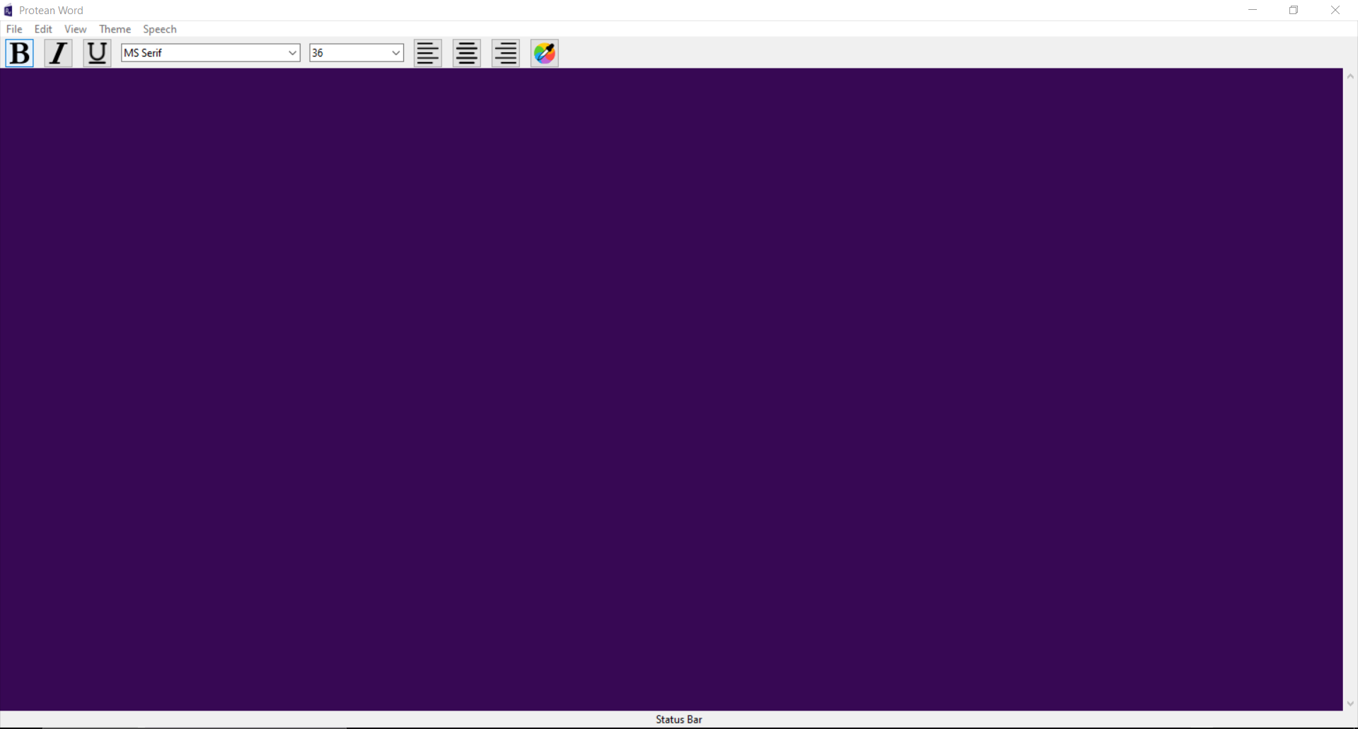
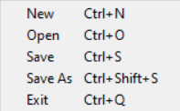
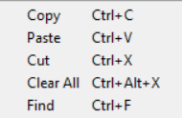
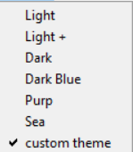


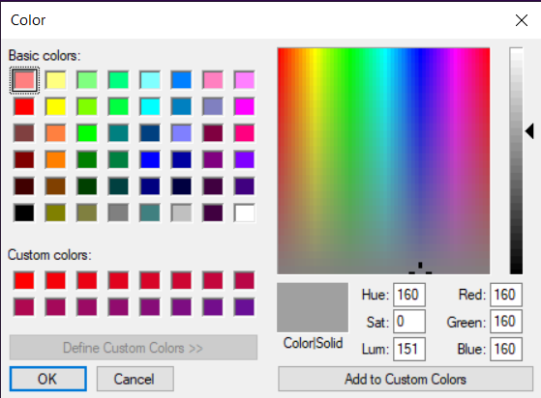

Slide 11
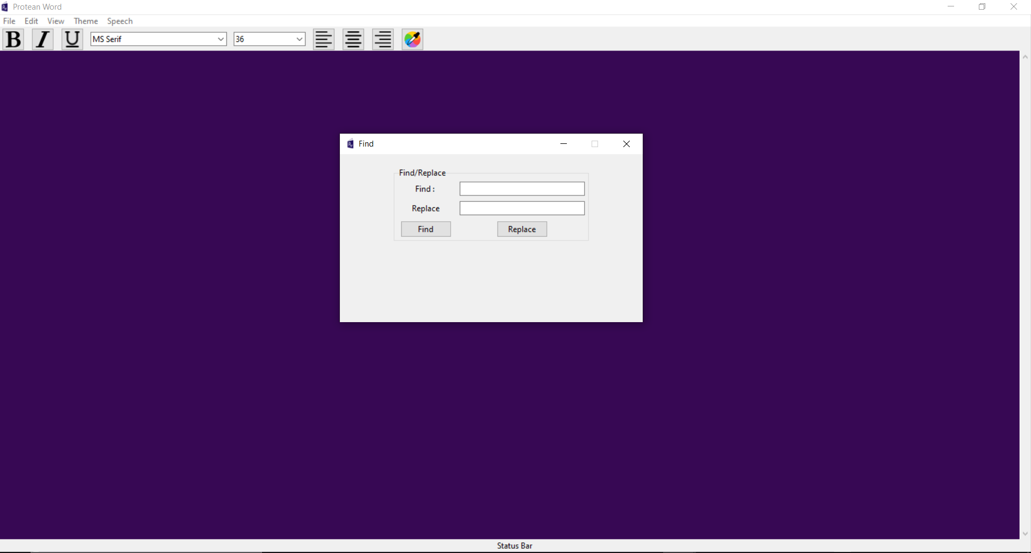

Slide 12
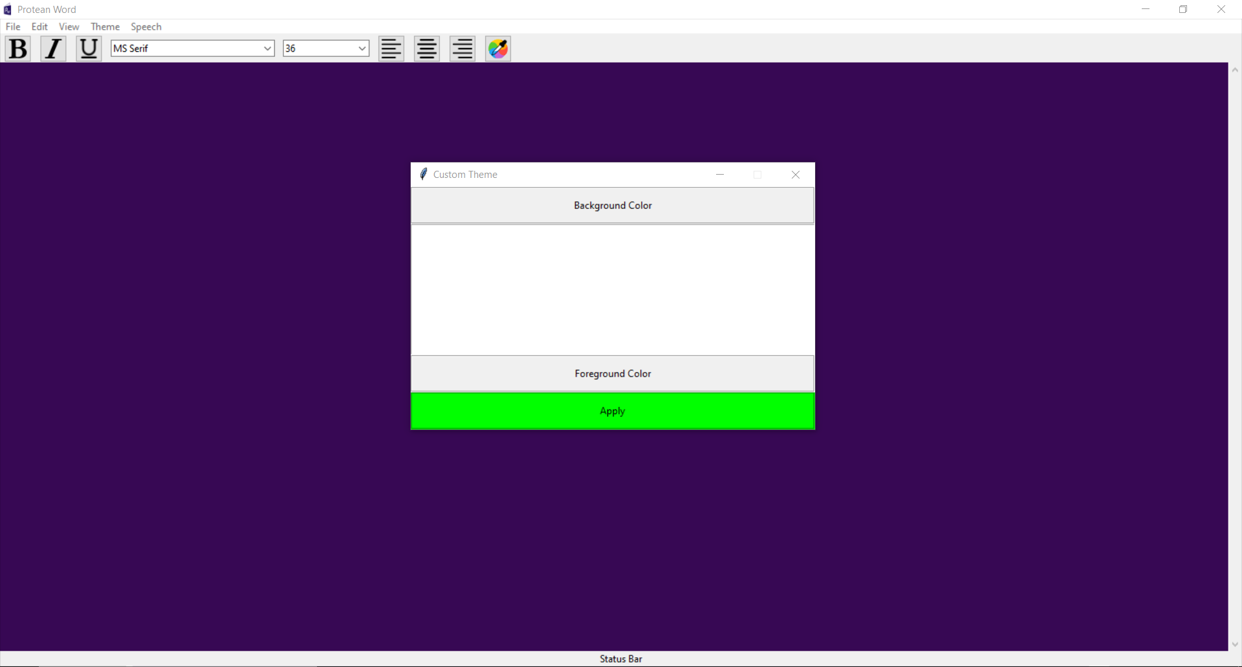

Slide 13
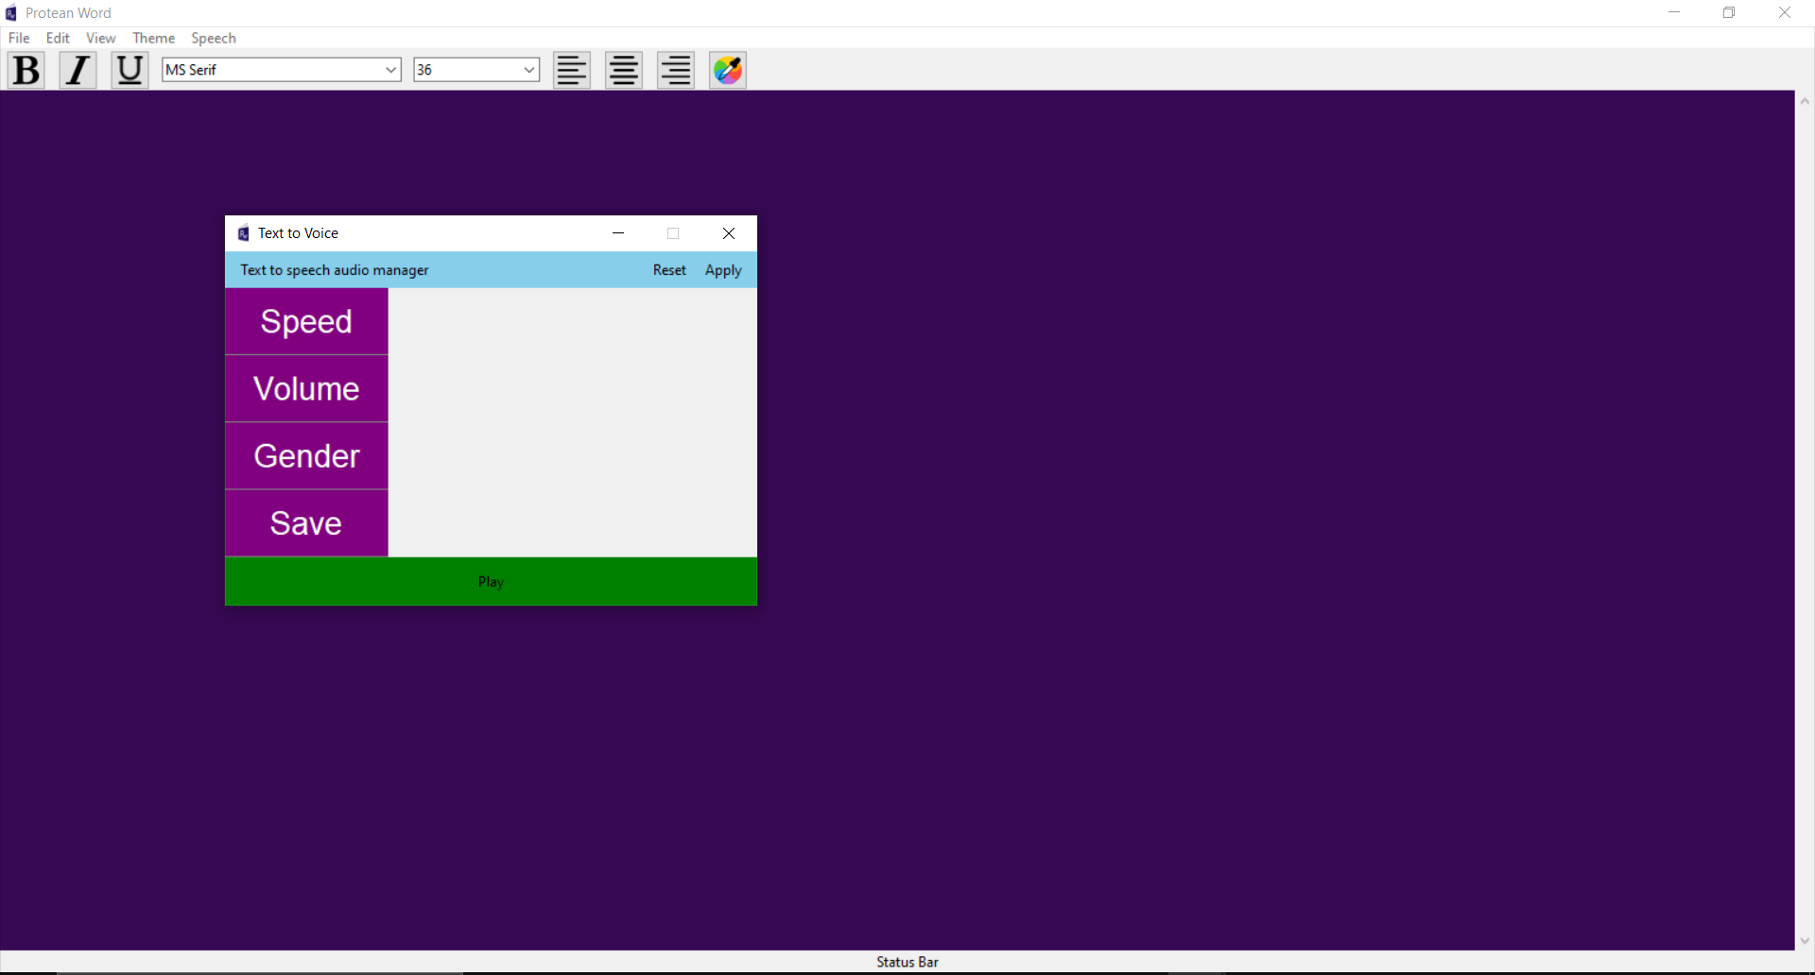

Slide 14
Future Enhancements
Allowing user to set their own canvas size.
Password protected file system.
Print option.
Loading formatted text in same format after saving.
Play and Pause speech.

Slide 15
Conclusion
Throughout this project, we were able to develop a text editor that allows user to edit and beautify plain text.
This project is simple, easy to understand and easy to operate.
Protean Word has a user-friendly GUI for the ease and comfort of user.

Slide 16
Vote of thanks:
Dr. Rajani Chulyadyo

